Slide 1
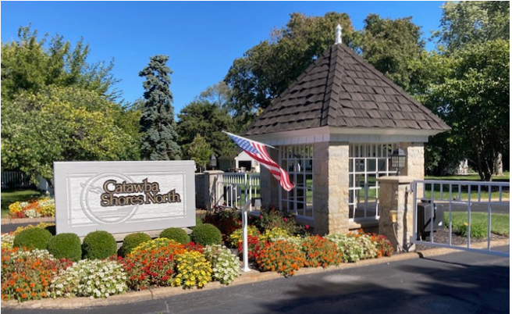
CSNCA Annual Meeting
September 14, 2024
Notes:
Line spacing + Page numbers

Slide 2
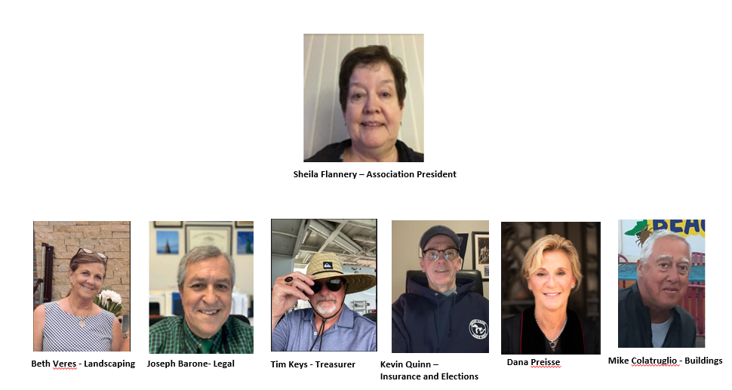
The Board’s Agenda
Agenda Items:
Welcome and Administration
Thank you to Kayman / Ley for attending
Nominations & Voting for Board Members
Finance
  Balance Sheet
  Web Site Navigation
Buildings
Landscaping
Pool/Beach
Social & Communication
Legal/Special Projects
Questions and Answers
Adjournment of Meeting
Social Gathering Around CSN Pool Area

Slide 3
WELCOME AND ADMINISTRATION:
Welcome
Introduce Board Members
Approve FY23 Annual Meeting Minutes from Sept 7, 2023
Approve House Bill 135 Waiver – Waiver needs to be signed and turned into sign-in table
  Thoughts of future goal of eliminating waiver by building reserve to Ohio state standards

Slide 4
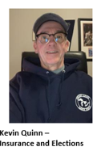
Voting for Board Members:
Explanation pertaining to this year’s election
Explanation of property insurance

Slide 5
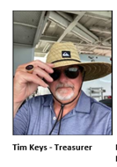
FINANCIALS:
Association Balances
  Reserves (End of June) $ 55,101
  Operations (End of June) $ 43,037
  1ST Nat Construction (Current) $ 125,000
  IntraFi Cash (ICS) (Current) $ 77,806
  CDARS (Current) $ 506,618
Review FY23 Actuals and FY24 Budget
Brief explanation of using reserve money to help us pay miscellaneous expenses (listed below in this presentation)

Slide 6
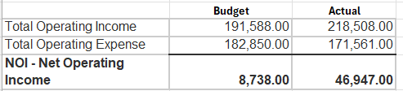
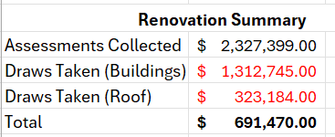
Association Financial Summary
←-- 28k is interest money
←-- mention next assessment
Notes:
19k after interest
Next assessment may be moved to March

Slide 7
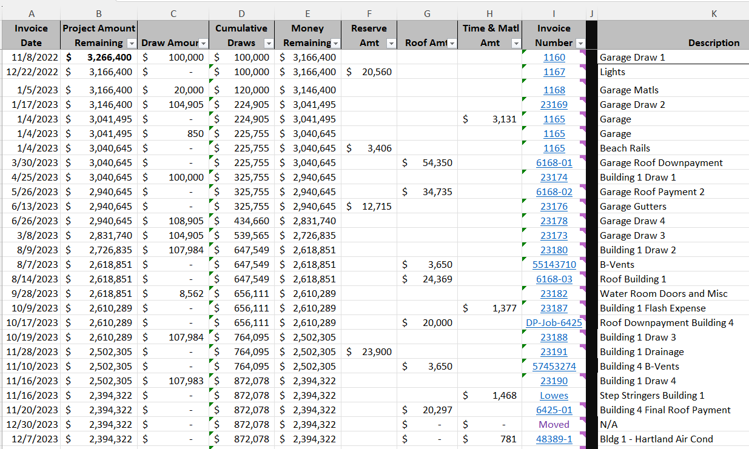
Keeping Track of Expenses

Slide 8
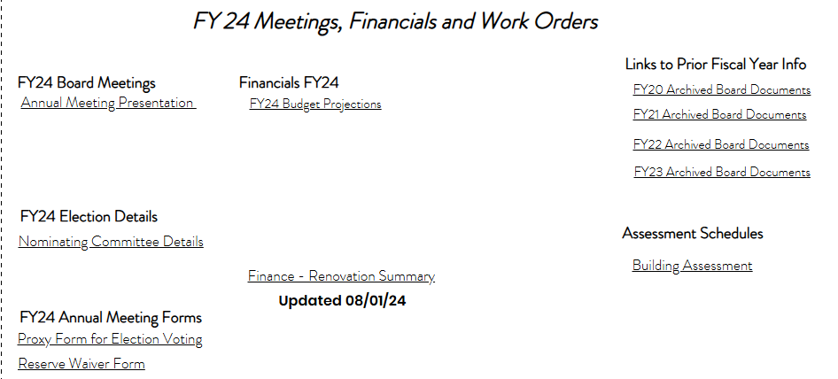
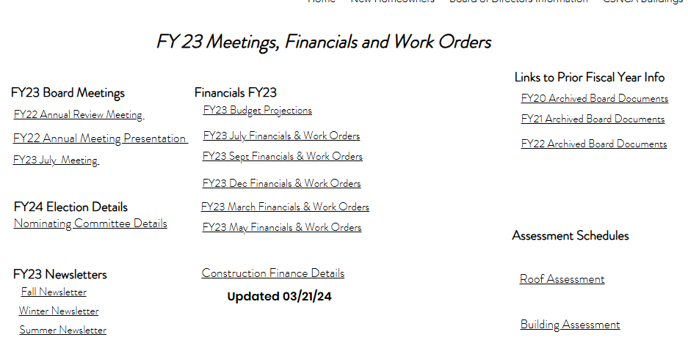
To Access Financials from our www.csnca.net
Hit “Board of Directors Info” link
Hit “Meetings, Financials and Work Orders” link
Type in Password = L@k3T1me

Slide 9
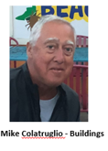
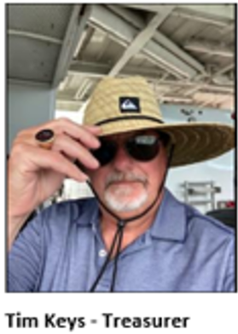
Building Renovation Project

Slide 10

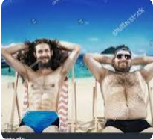
We wanted to stop the leaks
Eliminate as much maintenance cost as possible
Return this association back to its place of beauty and prominence in the Catawba community.
Defining the Mission – Important Objectives
How long will this project take?
Mike and Tim
We’ll get to that in a moment
Notes:
We’ll talk about “how long” during our presentation

Slide 11
Contract Terms
Roof Replacement
Drainage Improvements
Accomplishments Since 2023
Sidewalk Around Building 1
Grass Repair Around Building 1
Drink Rails – Building 1
Building 4 Status
Process/Material Changes
Window and Door Replacement
Figuring out added costs
Notes:
We’ll talk about “how long” during our presentation

Slide 12
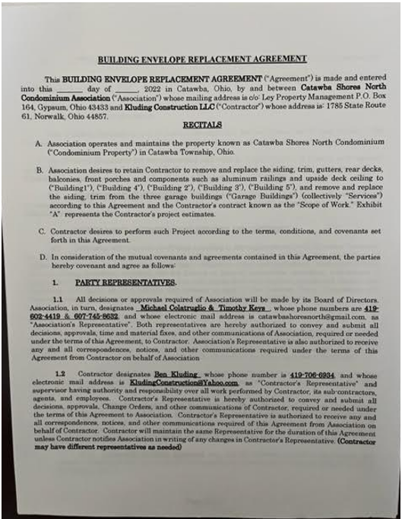
Contract Details With Kluding
Notes:
Ben’s Contract October 10, 2022
a. Some things we wanted in the contract- No dates or deadlines for finishing a building based on the principles that we had
been told repeatedly by contractors that the buildings were full of leaks, needed structural renovation (no OSB) and required attention
to detail. We were not looking for a quick fix or speed we want this project dome right.
b. The structure of payment was not based on hourly wages but rather on a draw system. The original fixed cost was based on a per
building basis. Ben does not get paid until he needs a draw from the total allotment of the contract and that number is fixed. Therefore,
our main focus is not with hours worked per week or whether or not he works a full Friday it is on meeting targets and reaching the goals
of the renovation. Moving slowly or fast is not the primary objective, it is to fix leaks, to get this project done right and make decisions that
reflect sound business decisions and visionary practice of using the latest renovation techniques while maintaining our sense of Cape Cod
beauty.

Slide 13
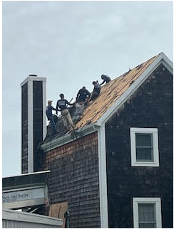
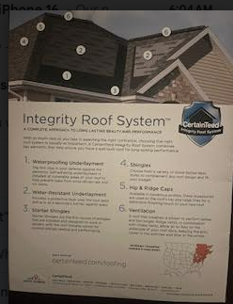
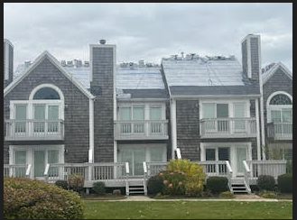
Roof Repair
Accomplishments Since Sept 2023
All buildings have been shingled with the CertainTeed 5 Star Warranty
  Material and Labor is covered for 30 years
  Workmanship is covered for 25 years
  15-year streakFighter algae-resistance
Notes:
All buildings on site have been completed. Cover warranty information.

Slide 14
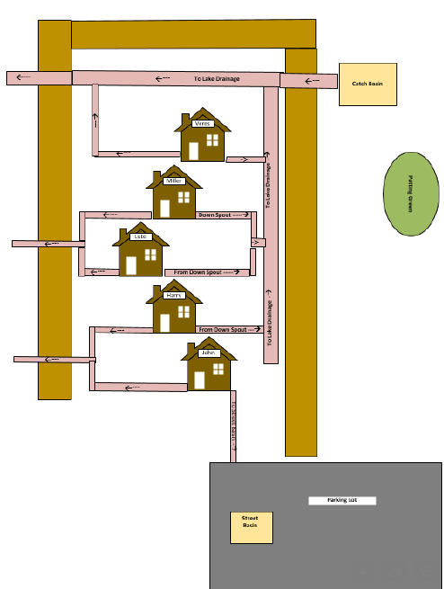
Drainage – Building 1
Accomplishments Since Sept 2023
(View looking from North Parking Lot to Pool) →
Notes:
Our approach to making improvements to drainage was to consult with the contractor, draw up sketches to avoid miscommunications, consult with the board and then commit to getting it done.

Slide 15
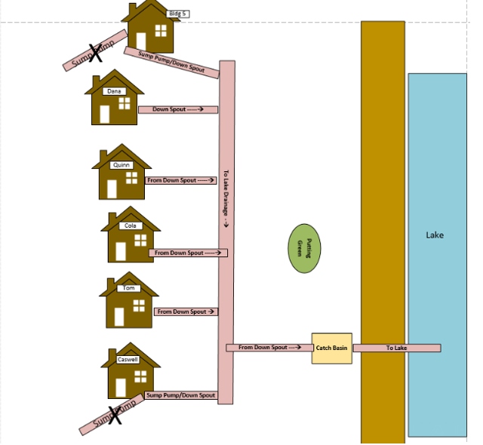
Drainage – Building 4
Accomplishments Since Sept 2023
(View looking from Caswell’s to Garden Units) →

Slide 16
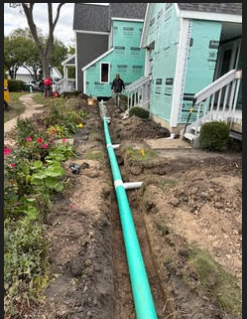
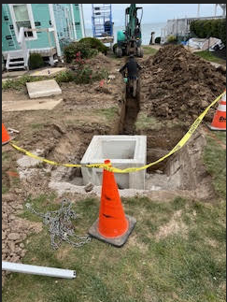
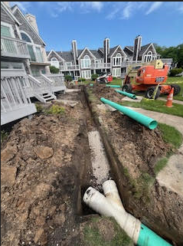
Drainage – Buildings 1 and 4
Accomplishments Since Sept 2023
After careful consideration, the board felt NOW was an opportune time to significantly improve property drainage.
Building 1 lakeside decks now have dedicated gutter drainage to the lake
Building 4 courtside decks now have dedicated gutter drainage to the lake
Sump pumps and downspouts now discharge into the main that leads to the new catch basin.

Slide 17
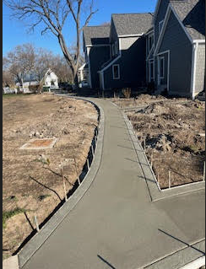
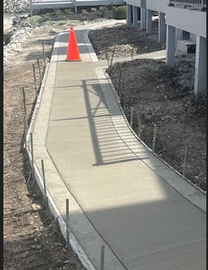
Sidewalk Repair
Accomplishments Since Sept 2023
Once drainage was completed, a new walkway could be installed
Walking hazards caused by raised walkway from tree roots were fixed

Slide 18
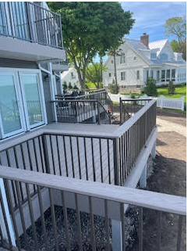
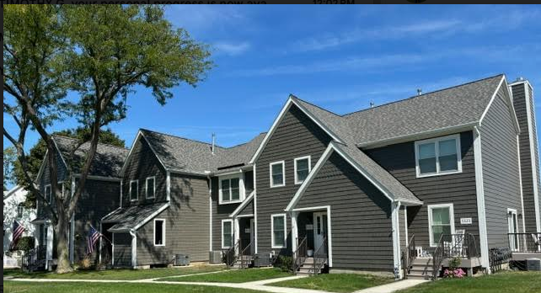
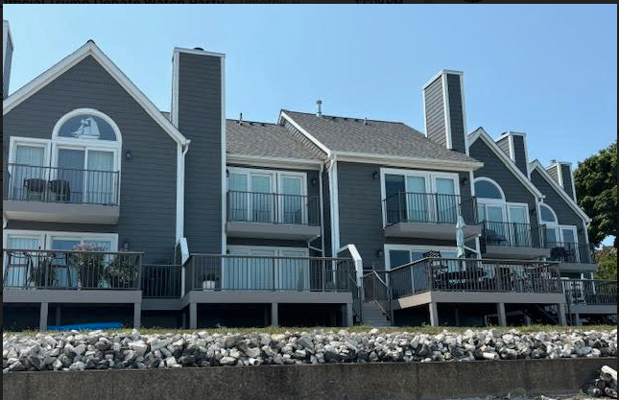
Building 1
Accomplishments Since Sept 2023
Notes:
Mention the fact that our buildings are old and not really build to today’s code. Therefore, we strive to make this place an A but we’re coming from a D- and sometimes may only achieve a B to B+.

Slide 19
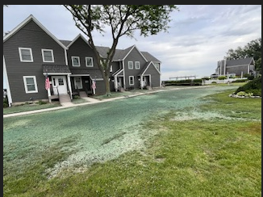
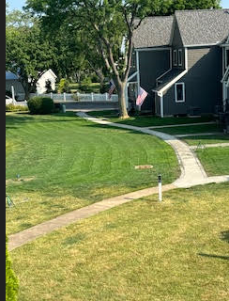
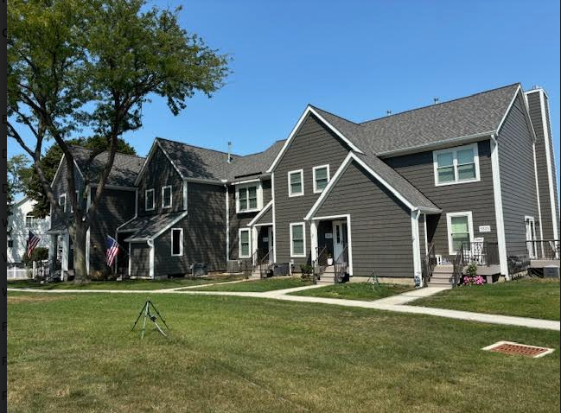
Grass Repair
Accomplishments Since Sept 2023
New grass will be treated late fall/early spring to control weeds

Slide 20
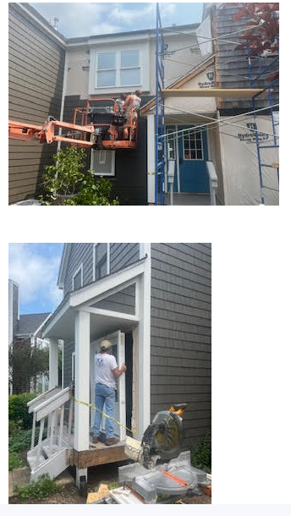
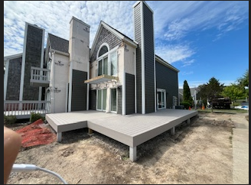
Building 4
Accomplishments Since Sept 2023
Second residential building remodel going relatively smooth
Notes:
Many ordered doors and windows and we hope owners are satisfied with the quality of the installation and the products themselves.

Slide 21
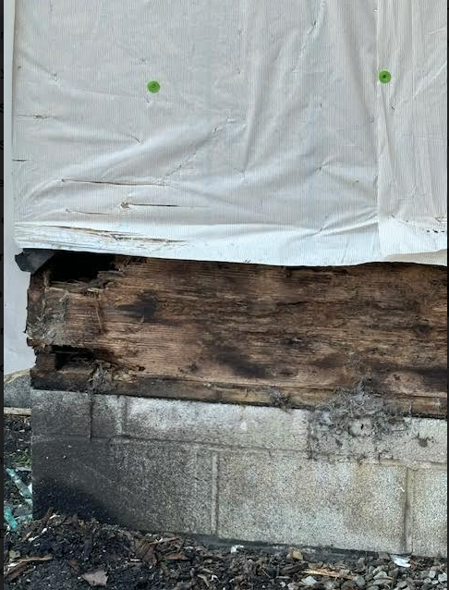
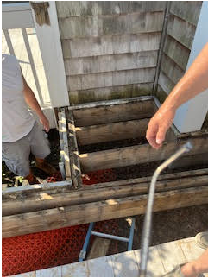
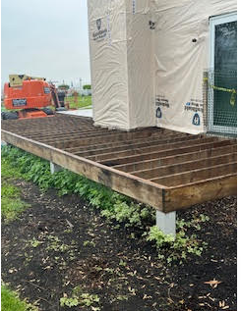
Building 4 – Deck Issues
Accomplishments Since Sept 2023
Discovered significant deck deterioration
Too much moisture trapped underneath decks
Required complete deck removal and replacement in some instances

Slide 22
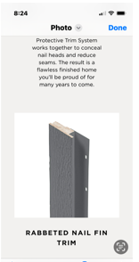
Trim and Vapor Barrier
Hydroshield vapor barrier change
Window trim design change
Changes

Slide 23
Added Costs – Some expected, some not
New porch and deck stair stringers
Address blocks
Flag holders
Walkway light fixtures
New cement walkway building 1
Drainage improvements
Up-side deck ceiling
Garage gutters
B-Vent Replacement
Porch lights
Deck deterioration
Landscape Replacement
Notes:
The point of this slide is just to convey some of the things we didn’t expect

Slide 24
Slider and Window Replacement
Homeowners can select the contactor of their choice to install doors and windows
We recommend Ray Schaeffer and Cliff Sams to install doors and windows
Ray Schaeffer handles Marvin and Anderson and is a contractor who can do repair if damage is found. Ray Schaeffer mainly handles sliding door installs.
Cliff Sams mainly handles Polaris and Pella. Cliff mainly installs front doors, storm doors and windows
Both contractors work closely with Kluding
Kluding will continue to perform walk-thru(s) to help homeowners evaluate door and window condition
New Policies Established

Slide 25
Every 9 months, complete a building
Landscape/Fence Replacement Plan - Have met with numerous companies for guidance and suggestions. We expect key decisions to be made soon.
Irrigation
Diamond Kote Sign off will be late Fall for Building 1 and
possibly Building 4.
Board is asking for you to offer suggestions of things you
would like to hang on the Diamond Kote. We will study and
get input from the company.
We try to stay positive – We believe our investment into our community will generate comparable returns (and maybe more).
Future Considerations

Slide 26
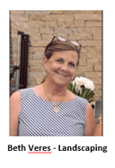
LANDSCAPING:
Introduce Committee Members
Landscaping update for FY 2024
Tree Trimming
Some Plans for 2024
lawn & ground maintenance update

Slide 27
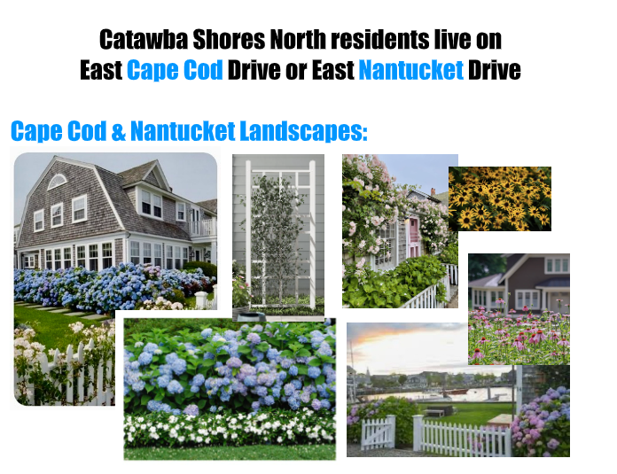
Landscaping
13

Slide 28
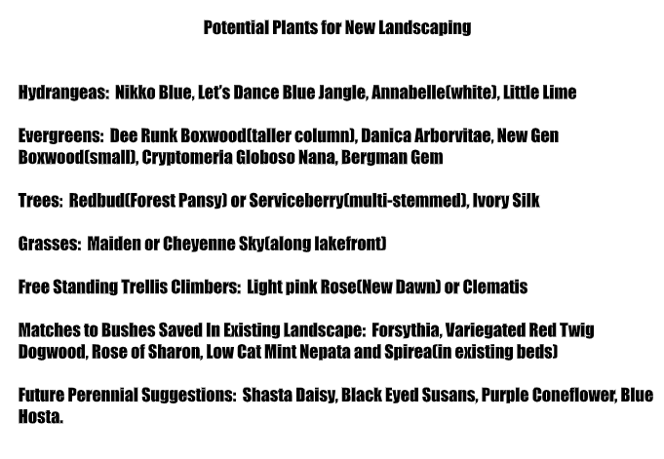
Landscaping
13

Slide 29
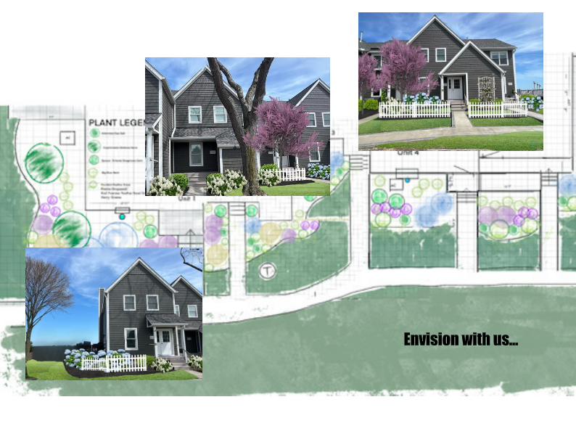
Landscaping
13

Slide 30
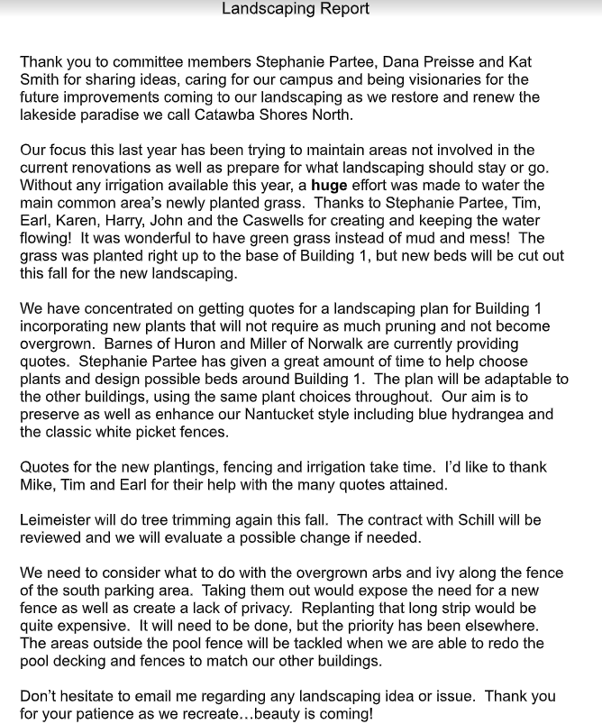
Landscaping
13

Slide 31
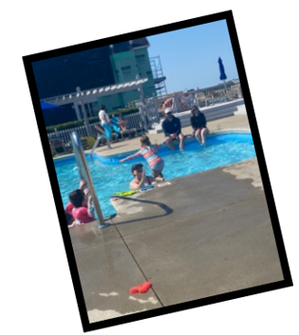
Pool
13

Slide 32
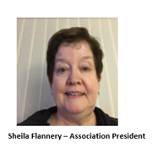
SOCIAL & COMMUNICATION:
LEGAL/SPECIAL PROJECTS:
Leash and Amendments

Slide 33
QUESTIONS & ANSWERS
ADJOURNMENT OF MEETING

